Slide 1
Bezier Curves
Course Code: CSC 3224
Course Title: Computer Graphics
Dept. of Computer Science
Faculty of Science and Technology
Lecturer No: | 11 | Week No: | 09 | Semester:
Lecturer:

Slide 2
Lecture Outline
Introduction of Curve Modeling
Introduction of Bezier Curves
Bezier Curves (Derivation)
Properties of Bezier Curves
Bezier Curves (Mathematics)

Slide 3
Introduction of Curve Modeling
Features
A system that supports users to design curves must be:
1. Intuitive: We expect that every step.
2. Flexible: The system should provide the users with more
control for designing and editing the shape of
the curve.
3. Easy: The way of creating and editing a curve should be easy.

Slide 4
Introduction of Curve Modeling
Features
4. Unified Approach: The way of representing, creating and
editing different types of curves (e.g.
lines, conic sections and cubic curves)
must be the same.
5. Invariant: The represented curve will not change its geometry
under geometric transformation (translation,
rotation, ………..)

Slide 5
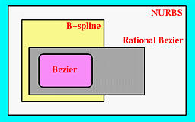
Introduction of Curve Modeling
Features
6. If necessary, a user can add control points
7. They are very geometric, intuitive.
8. The transition from the curve to surface will not cause much
difficulty.

Slide 6
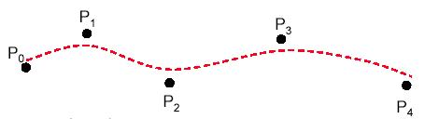
Bezier Curves
Features
Bezier splines are:
Spline approximation method
Useful and convenient for curve and surface design
Easy to implement
Available in CAD system, graphic package, drawing
and painting packages.

Slide 7
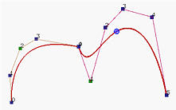
Bezier Curves
Features
Bezier splines are:
In general, a Bézier curve section can be fitted to any number of
control points.
The number of control points to be approximated and their relative
position determine the degree of the Bézier polynomial.

Slide 8
Bezier Curves

Slide 9

Bezier Curves
A Bezier curve is a parametric curve that uses Bernstein polynomial as a basis function/blending function.
Degree ‘n’ (order n+1) Bezier curve..

Slide 10
Blending Functions
Equation

Slide 11
Bezier Curve
Derivation
Lets take 4 control point

Slide 12
Example
Same way

Slide 13

Now consider coordinate x,y
B(t)$=P_{0}{(1−t)}^{3}$+$P_{1}{3t(1−t)}^{2}+P_{2}{3t}^{2}(1−t)$ + $P_{3}t^{3}$

Slide 14
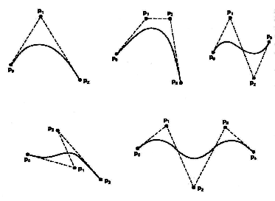
Properties of Bezier Curves
1. The degree of a Bézier curve defined by n+1 control points is n:
Parabola Curve
Cubic Curve
Cubic Curve
Cubic Curve

Slide 15
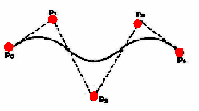
Properties of Bezier Curves
2. The curve passes though the first and the last control point C(u)
passes through P₀ and P_{n}.

Slide 16
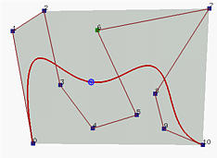
Properties of Bezier Curves
3. The Bézier curve lies completely in the convex hull of the given
control points.
Note that not all control points are on the boundary of the convex hull. For example, control points 3, 4, 5, 6, 8 and 9 are in the interior. The curve, except for the first two endpoints, lies completely in the convex hull.

Slide 17
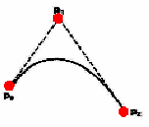
Properties of Bezier Curves
4. Moving control points:

Slide 18
Properties of Bezier Curves
5. The point that corresponds to t on the Bézier curve is the
"weighted" average of all control points, where the weights
are the coefficients B_{i,n}(t).

Slide 19
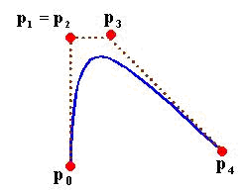
Properties of Bezier Curves
Design Techniques Using Bezier Curves (Weights)
6. ‍‍Multiple control points at a single coordinate position gives
more weight to that position.

Slide 20
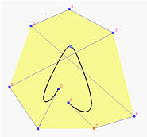
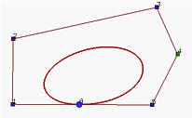
Properties of Bezier Curves
Design Techniques Using Bezier Curves (Closed Curves)
7. ‍‍Closed Bézier curves are generated by specifying the first and the
last control points at the same position.
4
5
3
2
0
8
6
1
7
‍‍Note: Bézier curves are polynomials which cannot represent circles and ellipses.

Slide 21
Problem Solving (Bezier Curve)
Constant Bezier curve for control points (4,2) (8,8) and (16,4)

Slide 22
Now we know:

Slide 23
Problem Solving
Now consider X,Y coordinate:

Slide 24
Problem Solving
Now consider 3 control point..
(4,2) (8,8) and (16,4)

Slide 25
Now put t value into 3,4 equation
t | x(t) | y(t)
0 | 4 | 2
0.2 | 5.76 | 4.0
0.4 | 7.48 | 5.2
0.6 | 10.24 | 5.6
0.8 | 12.96 | 5.2
1.0 | 16 | 4

Slide 26
Now Draw the curve …
Put the x,y value

Slide 27
Books
Foley, van Dam, Feiner, Hughes, Computer Graphics: principles and practice, Addison Wesley, Second Edition.
Schaum's Outline of Theory & Problems of Computer Graphics.
Peter Shirley Steve Marschner , “Fundamental of computer graphics”, Third Edition.

Slide 28
References
https://en.wikipedia.org/wiki/B%C3%A9zier_curve
http://www.ecartouche.ch/content_reg/cartouche/graphics/en/html/Curves_learningObject2.html
https://dev.to/isaacdlyman/explain-how-to-readwrite-bezier-curves-like-im-five
https://www.slideshare.net/ArundhatiKanungo/bezier-curves-79014994
https://typography.guru/directory/website/animated-b%C3%A9zier-curves-r348/
http://www.ams.org/publicoutreach/feature-column/fcarc-bezier

